Slide 1
Lesson 8 - Bouncing Ball
Mr Mack 2019

Slide 2
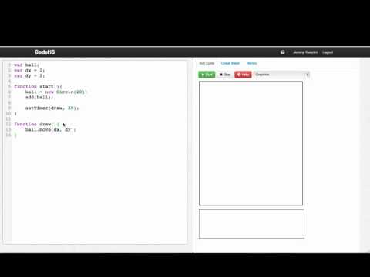

Slide 3
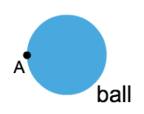
This is a Circle object on our canvas named ball. Point A is on the far left edge of the circle. How can we calculate the x-coordinate of point A?
ball.getX();
ball.getX() + ball.getRadius();
ball.getY() + ball.getRadius();
ball.getX() - ball.getRadius();

Slide 4
Which statement should we use to determine if ball is hitting the left edge of the window?
if(ball.getX() - ball.getRadius() <= 0){
//ball is hitting left edge
}
if(ball.getY() >= getHeight()){
//ball is hitting left edge
}
if(ball.getX() - ball.getRadius() >= getWidth()){
//ball is hitting left edge
}
if(ball.getY() <= 0){
//ball is hitting left edge
}

Slide 5
Example: Bouncing Ball
This is an example for this lesson. You are encouraged to play around with it, run and change the code, and learn how it works. When you are done, click continue to go to the next problem.

Slide 6
Exercise 3.8.1: Hotspot Ball
Extend our bouncing ball program to make it a “hotspot ball.” A hot spot ball is a ball that changes colors depending on what part of the screen it is on. If it is on the left side of the screen it should be blue, and if it is on the right side of the screen, it should be green.
If you want to try extending this program, can you break the window into quadrants? (This means you have 4 different regions: one for the top left, one for the top right, one for the bottom left, and one for the bottom right.)

Slide 7
Exercise 3.8.2: Trail
Extend the bouncing ball program to draw a trail. You can do this by drawing a smaller circle of a different color at the location of the ball every time the ball moves.
You should make the radius of the circles in the trail half the radius of the ball. The color of the trail should be cyan.
Also, you should stop the ball (stop the timer) after the ball bounces MAX_BOUNCES times.
Remember to use helper functions.
You can change the MAX_BOUNCES constant and the starting dx and dy to generate different drawings. Don’t make MAX_BOUNCES too high, though, or it could slow down your program a lot.

